Slide 1
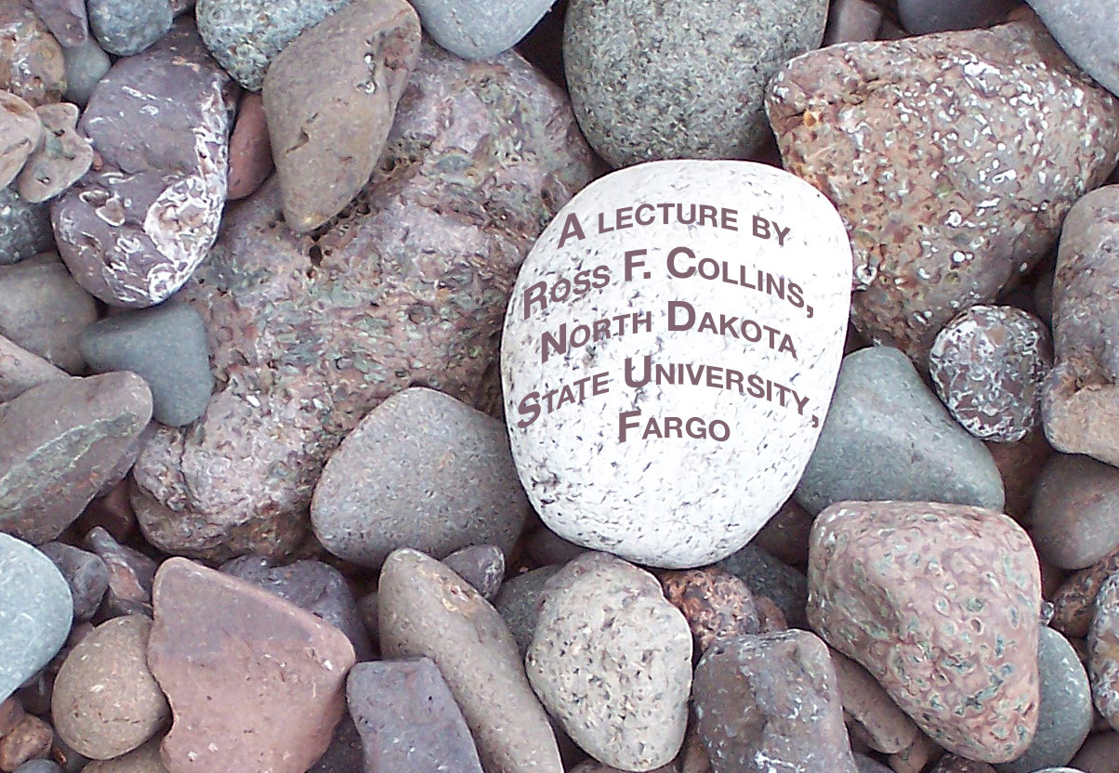
News photography
Telling the story of spot news

Slide 2
Spot news
Spot news usually means a photo tied to a time-sensitive news event based on traditional news values such as:
Timeliness.
Proximity.
Consequence.
Conflict.
Prominence.
Human interest.

Slide 3
Typical spot news
Typical spot news events include:
Meetings.
Accidents.
Fires.
Weather.
Conventions.
Political events and protests.

Slide 4
Planning for spot news
You often don’t know when a spot news event will happen. But you can anticipate what you’ll need to do.
In general, people are what matter in spot news. You’ll need pictures of people, with identification.
Consider that spot news assignments will usually give you one chance to get the picture. You probably won’t be able to go back and do it again.

Slide 5
Basic shots
Standard approach to spot news is to make sure you have three basic shots:
Long shot. Establishes the scene, how people are relating, who is involved. Shows scale.
Medium shot. Close eough to identifiy individuals, some detail, but still part of the general setting.
Close-up. Show details, add emphasis and impact. Tight photos of faces, objects, or parts of a scene.

Slide 6
Saturation shooting
Photojournalism requires you to move. Saturation shooting means capturing pictures from just about every angle.
Shoot high angles, low angles, all sorts of different scenes.
Within this process, try to find photos that capture a peak moment, or a decisive image.
You have to work fast; your camera’s controls should become so familiar you don’t have to think about them.

Slide 7
Two cameras
Photojournalists traditionally carried two or three cameras so they could shoot without changing lenses or film.
Today we seldom use film, but we do change lenses.
Having one camera body with a wide-angle faster zoom, and another with a longer, but slower, telephoto, gives you options while you work an event.

Slide 8
Shooting clichés
Try to avoid photojournalism clichés. But go ahead and shoot them anyway. At least you’ll have something.
Beyond that look for something different, unusual, more dynamic, or a detail other photographers may overlook.
Move to a different spot. Try to find unusual lighting. Make your photos stand out!

Slide 9
News photo clichés
In news photography we consider these to be clichés to avoid, if possible:
Boring photos of a speaker behind a podium. Look for something different; a gesture, an unusual angle, a facial expression. Wait for just the right moment.
Meeting shots of people at a table talking. As above, look for unusual expressions, or try to add depth with foreground elements.

Slide 10
More news clichés
Grip ’n grin. Also called a check-passing photo, as a person gives a check, certificate or award to another. Boring! Take a photo of what the person did to get the award.
Grand openings, especially ribbon-cutting ceremonies.
People holding trophies.
Group of people posing against a wall.
People talking into microphones.
People with arms crossed, facing the camera.

Slide 11
Wait around
Often you’ll find the best photos either before, or after, an event. Don’t leave right after it’s over.
A political candidate may be talking to a family after a news conference.
A speaker may be demonstrating an aspect of his work.
A trophy winner may be celebrating with friends.

Slide 12
Weather clichés
Weather news photography generally has to involve people, and the effect the weather is having on their lives.
Set yourself up at a busy intersection clogged with snow or puddles, and wait for something to happen.
Put your camera in a plastic bag with a hole cut out for the lens.
I love weather photography!

Slide 13

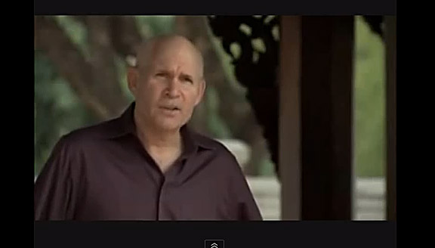
Great photojournalists: Steve McCurry
Steve McCurry of Magnum Photo agency is one of the most famous documentary photojournalists working today. He’s best known for his photo of the “Afghan Girl” http://www.youtube.com/watch?v=iXoJBc2IojI

